Slide 1

The Growing Popularity of Electric Vehicles (EV)
among Consumers
Powered by:
Kayla Jehnzen
Lakia White
Lyane Batchi
Sheena Pickett

Slide 2
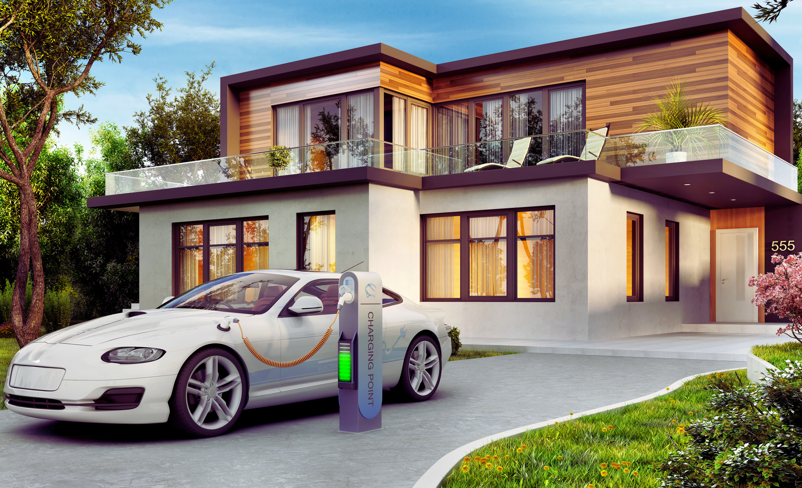
EVs gaining consumer interest
Electric vehicle consumer interest on the rise
EVs have a lower environmental/Economic impact than traditional vehicles.
Consumer interest in electric cars has significantly increased over the past few years due to the eco-friendly nature of EVs, fuel and energy cost, and the availability of charging stations.

Slide 3
Key Terminology
Electric Vehicle (EV): A vehicle that operates, either fully or partially, using electricity as its primary power source.
Battery Electric Vehicle (BEV): An electric vehicle that runs entirely on electricity stored in a battery pack. BEVs do not have an internal combustion engine and produce zero tailpipe emissions.
Plug-in Hybrid Electric Vehicle (PHEV): A type of hybrid vehicle that combines an internal combustion engine with an electric motor and a rechargeable battery.
Range: The maximum distance an electric vehicle can travel on a single charge or a full tank of electricity.
Battery Pack: The collection of individual battery cells that store electricity and power the electric motor(s) in an EV. Battery packs vary in size, capacity, and chemistry and are a significant component of an EV's cost and performance.

Slide 4
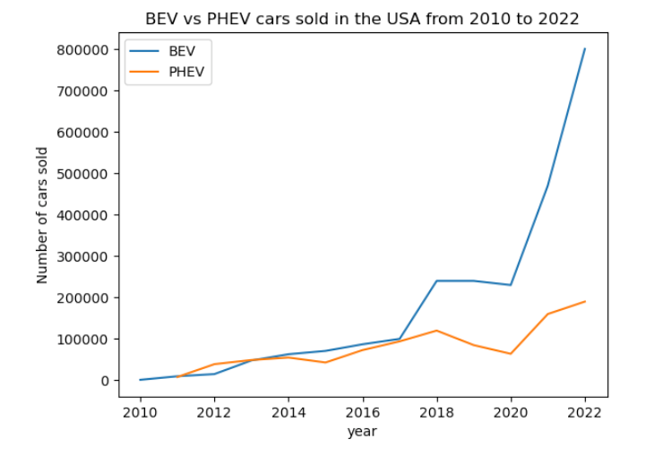
EVs: A Growing Trend
Chart displays EV purchases by year
The chart depicts the increasing trend of consumer interest in purchasing Electric Vehicles (EVs) over time. The data shows a steady rise in EV purchases each year, indicating a growing preference for environmentally friendly and cost-effective modes of transportation.

Slide 5
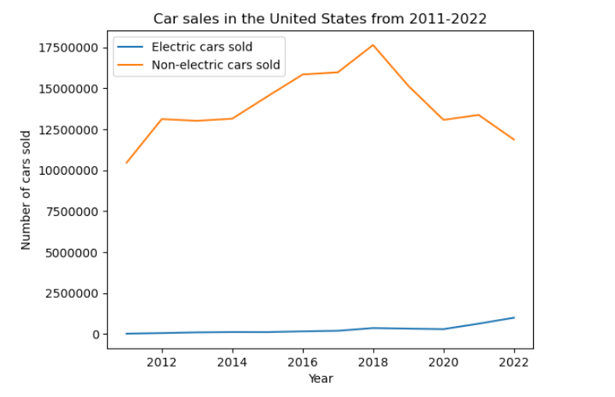
EVs: A Growing Trend

Slide 6
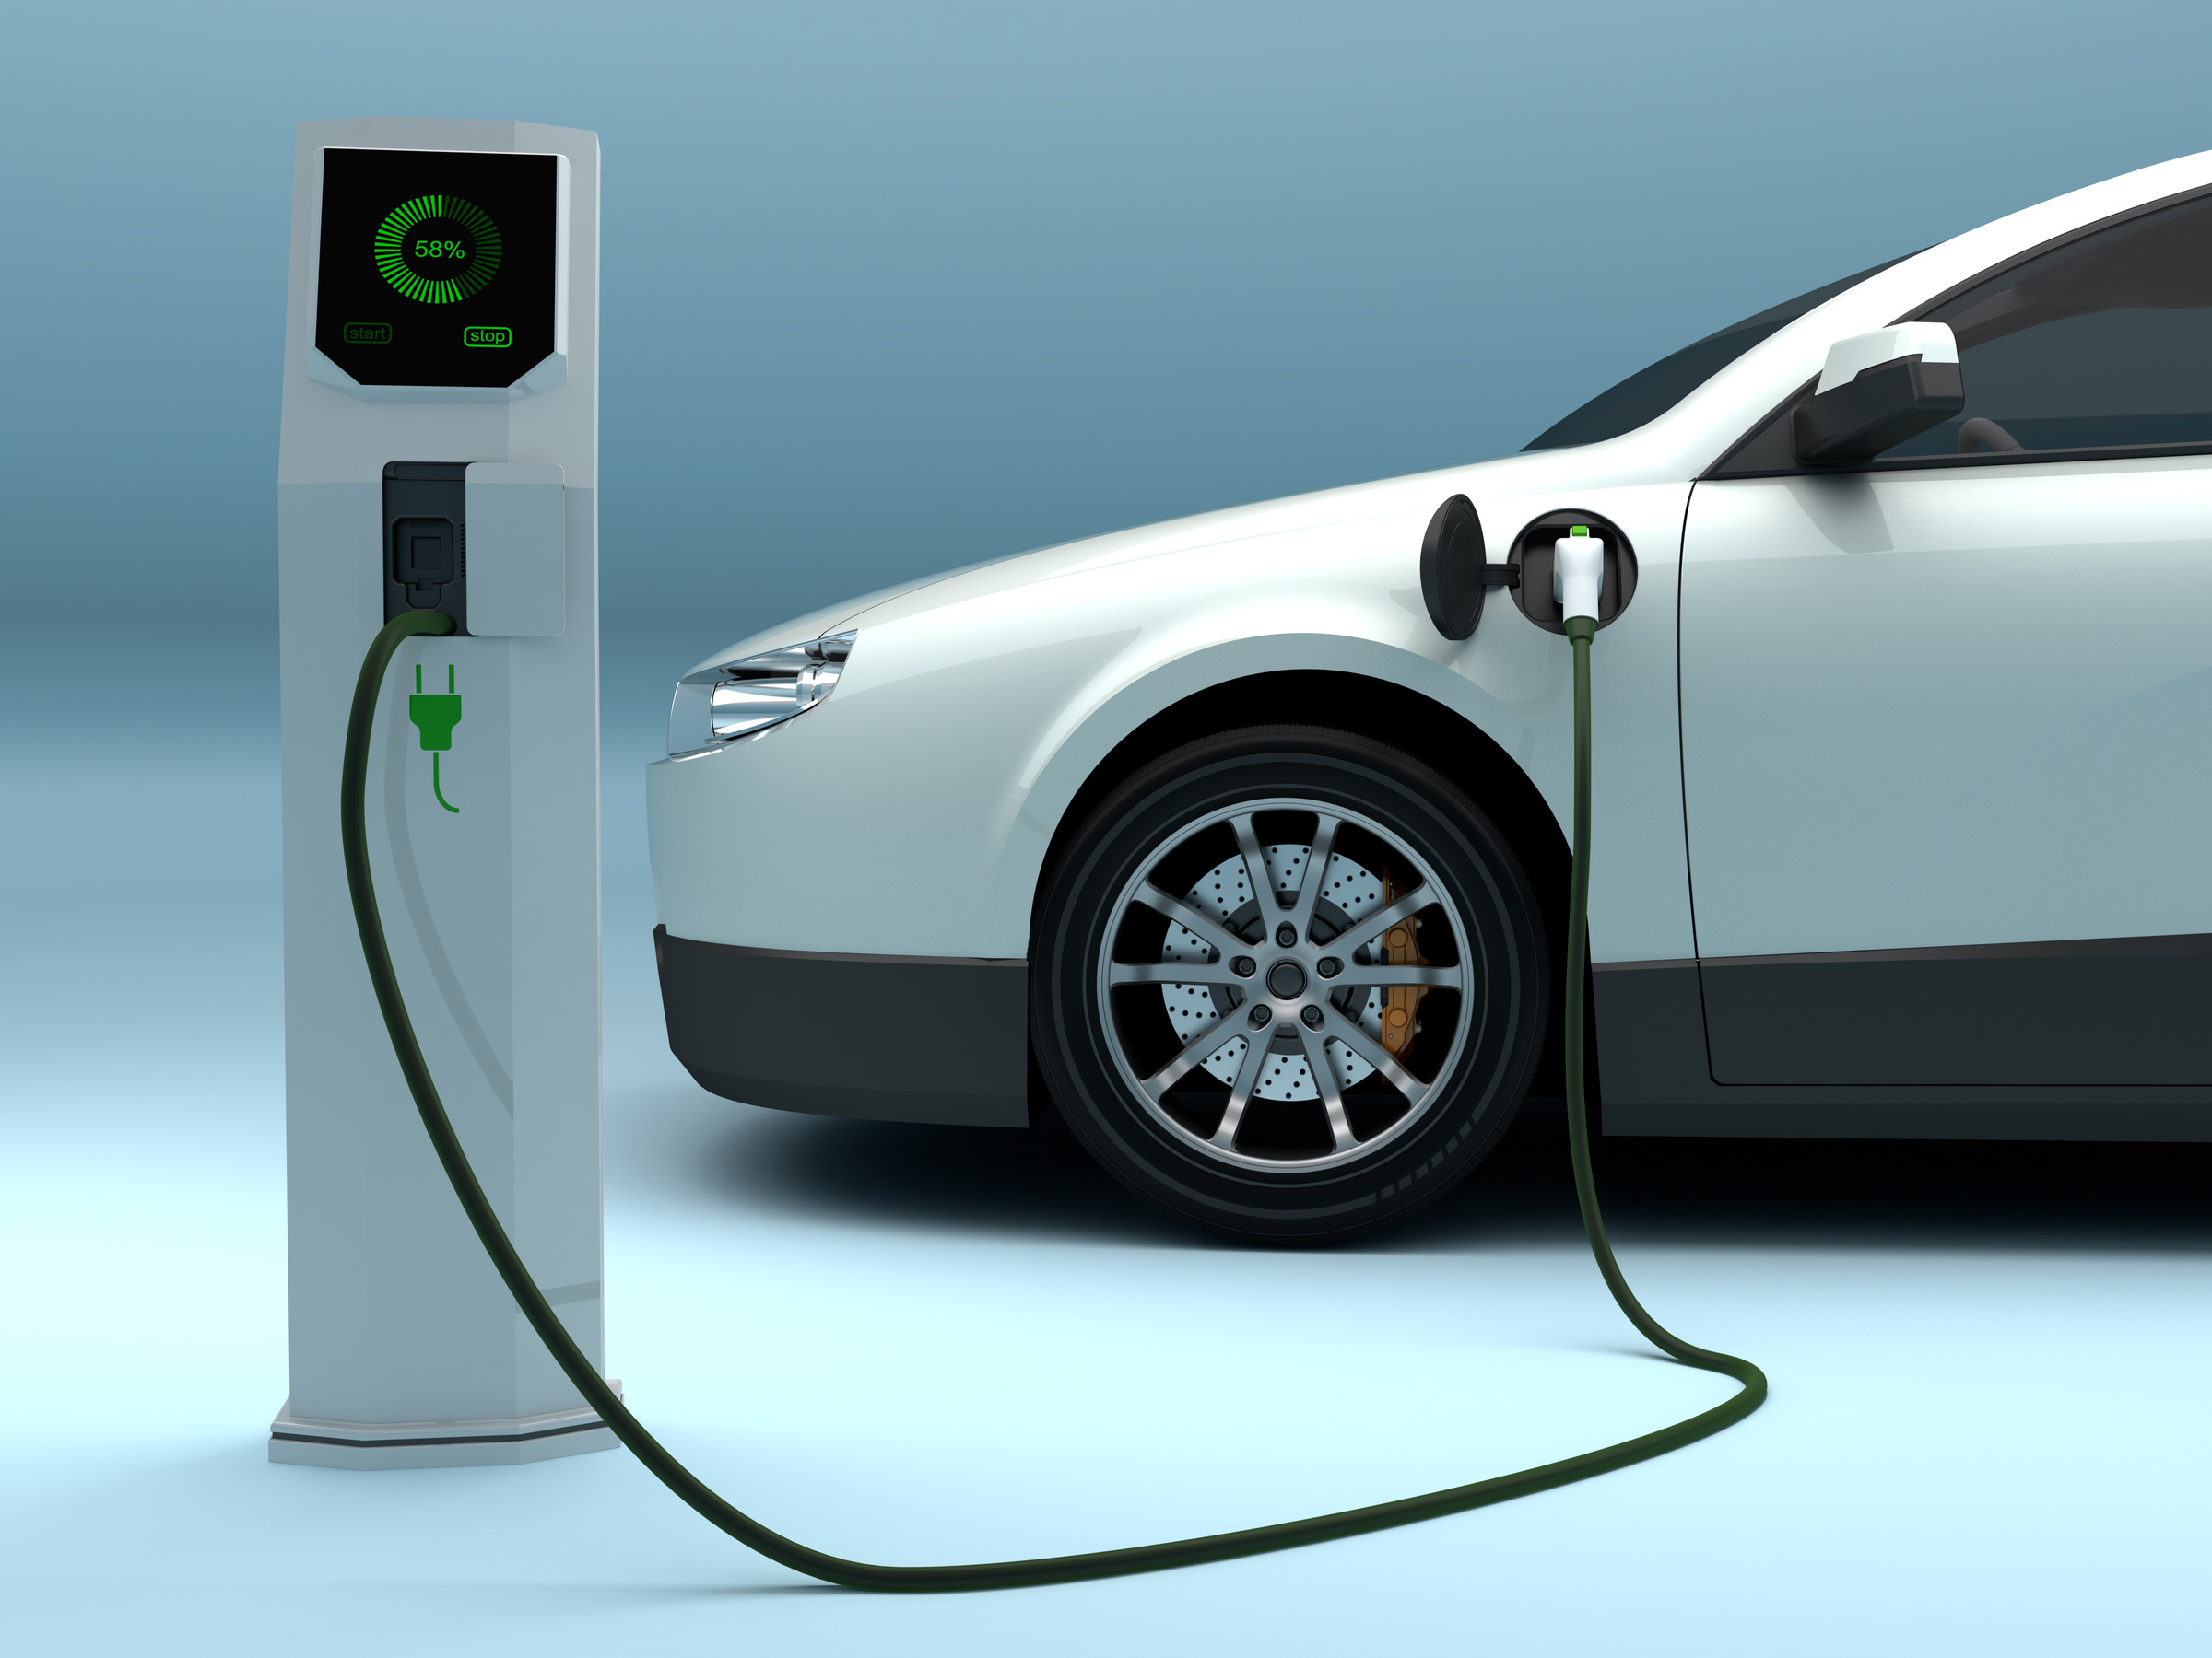
EVs: Purchasing Price
EVs typically have higher upfront purchase prices compared to traditional vehicles with internal combustion engines. This is primarily due to the cost of battery technology, which is a significant component of an EV's overall price.
However, prices for EVs have been decreasing steadily as battery technology improves, production scales up, and manufacturers achieve economies of scale.
Government incentives and subsidies are often available to reduce the initial cost of purchasing an EV, making them more competitive with traditional vehicles. These incentives can include tax credits, rebates, and grants aimed at promoting clean transportation.

Slide 7
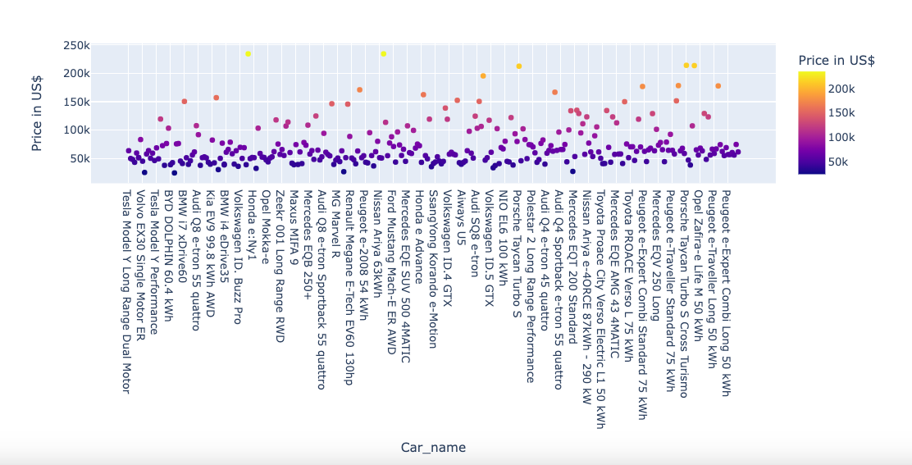
EVs: Purchasing Price
Price in US Dollar by Car Names

Slide 8

Traditional Vehicle Purchasing Price
Traditional vehicles with internal combustion engines have a wide range of prices depending on factors such as brand, model, size, and features.
Generally, traditional vehicles may have lower upfront purchase prices compared to EVs of similar size and features.
However, it's essential to consider the long-term operating costs, including fuel expenses and maintenance, when comparing the total cost of ownership between traditional vehicles and EVs.

Slide 9
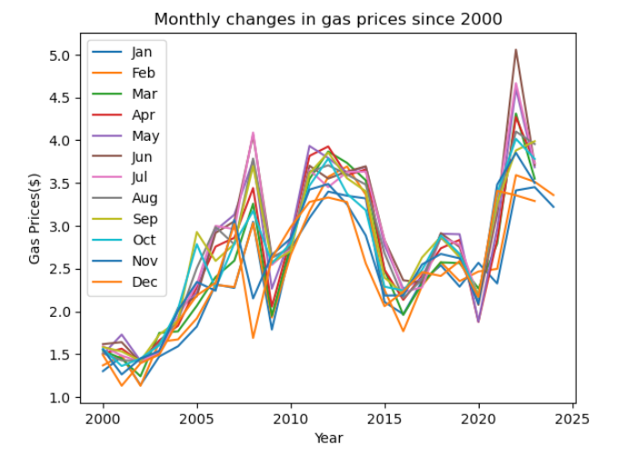
EVs: Fuel and Energy Cost
EVs generally have lower fuel costs compared to traditional vehicles running on gasoline or diesel. Electricity is often cheaper per mile than gasoline or diesel, and EV owners may have access to charging stations where they can charge their vehicles for free or at a reduced cost. Over the long term, savings on fuel costs can be significant, especially if the price of electricity remains stable or decreases.

Slide 10
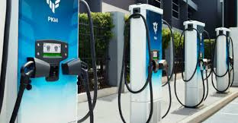
Expansion of Electric Vehicle Charging Infrastructure.

Slide 11
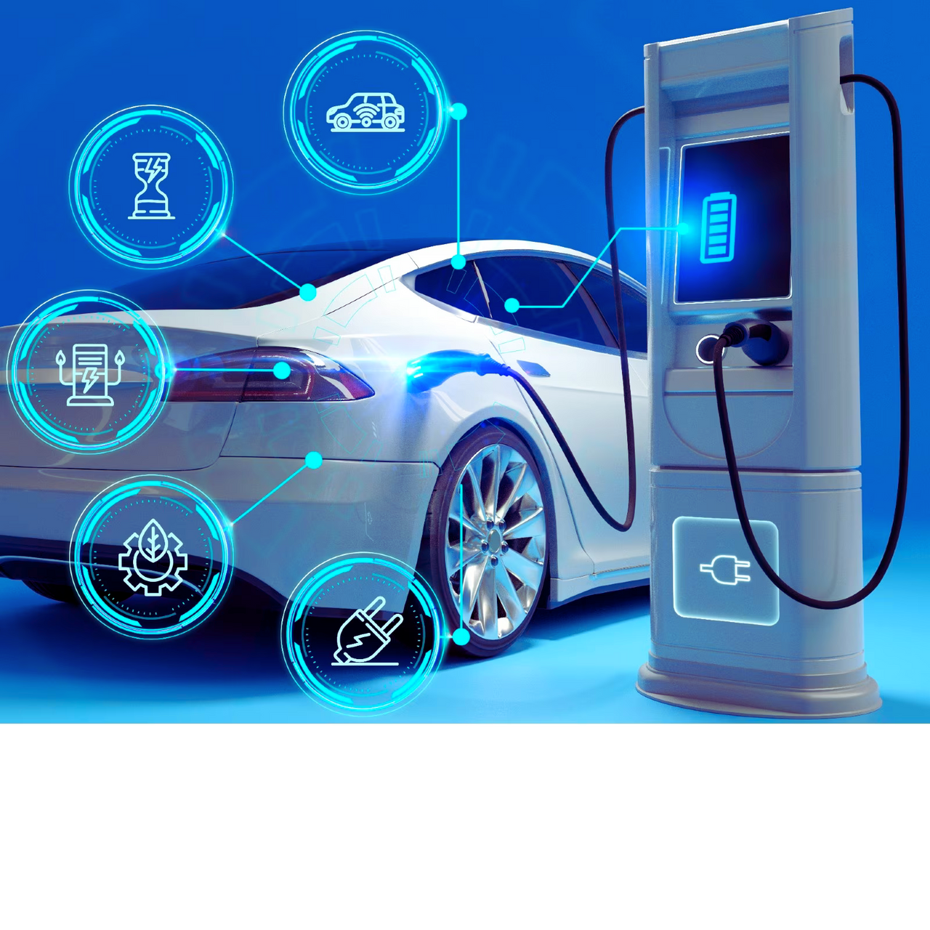
Several factors contribute to this growth:
Government Initiatives
Private Investment
Automaker Involvement
Consumer Demand
Charge/Range anxiety
Technological Advances
Urban Planning

Slide 12

EVs: Charging Stations

Slide 13
The future of electric vehicles (EVs) appears promising, with several trends shaping their continued growth and adoption:
The Electric Revolution Ahead
Advancements in Battery Technology
Expansion of Charging Infrastructure
Diverse Vehicle Offerings
Policy Support and Regulations
Integration with Renewable Energy
Technological Innovation
Environmental and Economic Benefits

